Slide 1
Overview of Downscaling
Kenneth E. Kunkel
NOAA Cooperative Institute for Climate and Satellites
North Carolina State University

Slide 2
PURPOSE OF DOWNSCALING
To produce climate information and projections
that can be used to assess the impacts of climate variability and change
on human and natural systems
whose processes operate at finer spatial and/or temporal scales than a typical global model

Slide 3
OUR PURPOSE
To produce climate information and projections
that can be used to assess the impacts of climate variability and change
on human and natural systems
whose processes operate at finer spatial and/or temporal scales than a typical global model

Slide 4
OUR PURPOSE
To produce climate information and projections
that can be used to assess the impacts of climate variability and change
on human and natural systems
whose processes operate at finer spatial and/or temporal scales than a typical global model

Slide 5
OUR PURPOSE
To produce climate information and projections
that can be used to assess the impacts of climate variability and change
on human and natural systems
whose processes operate at finer spatial and/or temporal scales than a typical global model

Slide 6
Global Climate Models (GCMs)
Why is there the need to downscale Global Climate Model data?
First, what happens in a GCM?

Slide 7
Global Climate Models (GCMs)
The earth’s atmosphere is broken into grid boxes
Typical horizontal dimensions of grid boxes is 100-200 km
Equations that describe atmospheric processes are solved for each grid box
Each grid box is characterized by a single value of temperature, precipitation, humidity, and other state variables at each time step

Slide 8
Global Climate Models (GCMs)
Surface topography is resolved at the same dimensions (100-200 km): the surface is essentially a set of 100-200 km plateaus
As a result, details of topographically-induced climate features are not well simulated in mountainous regions
  Upwind enhancement of precipitation; rain shadows, etc.

Slide 9
Global Climate Models (GCMs)
In addition, some important physical processes and meteorological phenomena occur at smaller scales than the typical GCM resolution
One of these is convective precipitation, which is the dominant form in warm seasons and climates

Slide 10
Examples of GCM simulation data

Slide 11
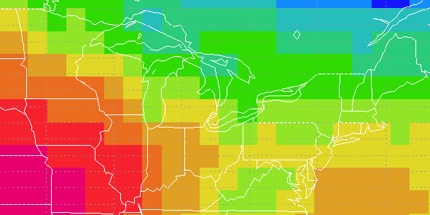
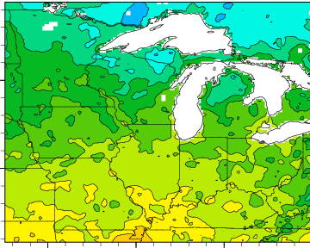
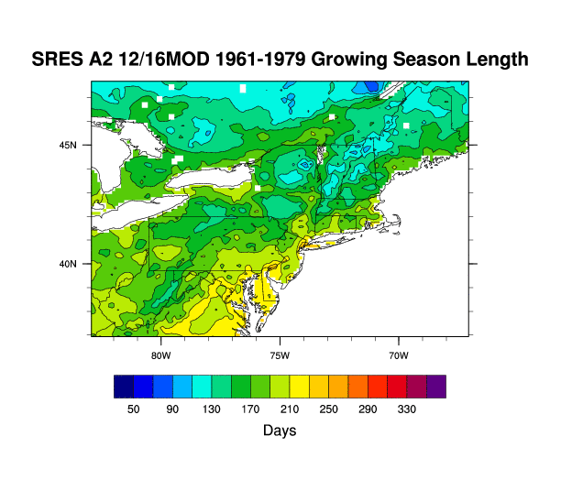
FROM GLOBAL TO LOCAL
GROWING SEASON LENGTH
2m TEMPERATURE

Slide 12
Example – Pune

Slide 13
What is downscaling?
DOWNSCALING introduces new information into global climate model output to generate high-resolution climate projections

Slide 14
What is downscaling?
DOWNSCALING introduces new information into global climate model output to generate high-resolution climate projections
Where does this new information come from?
from higher-resolution modeling of physical processes
from observations

Slide 15
What is downscaling?
DOWNSCALING introduces new information into global climate model output to generate high-resolution climate projections
Where does this new information come from?
from higher-resolution modeling of physical processes
from observations
EMPIRICAL-STATISTICAL MODELING
REGIONAL
CLIMATE MODELING

Slide 16
Empirical-Statistical Downscaling Techniques
Use historical observations and model simulation of historical period to “train” a statistical model
Apply statistical relationships to model simulation of future (this assumes that these relationships remain constant in the future)

Slide 17
Statistical Downscaling Techniques
Simple bias correction (”delta” model):
Variance correction
  Inflate or deflate magnitude of daily variations

Slide 18
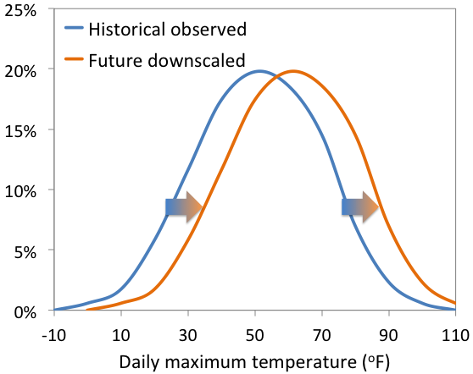
Delta Change
Calculates average difference between present and future GCM simulations, then adds that difference to the observed time series for the point of interest

Slide 19
Statistical Downscaling Techniques
Quantile mapping – use entire probability density function, the major aim being to ensure that the extreme values are properly represented

Slide 20
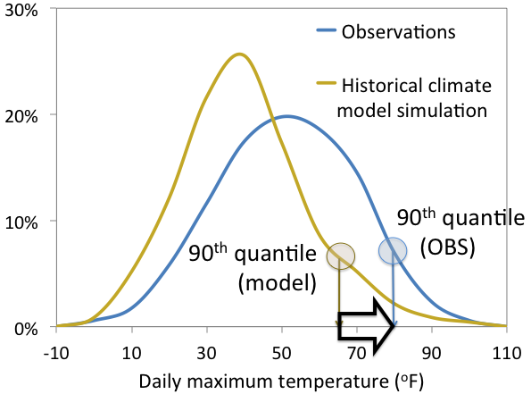
Empirical Quantile Mapping
Projects PDFs for monthly or daily simulated GCM variables onto historical observations

Slide 21
Statistical Downscaling Advantages
Computationally inexpensive
Modern techniques produce good representation of extreme tails

Slide 22
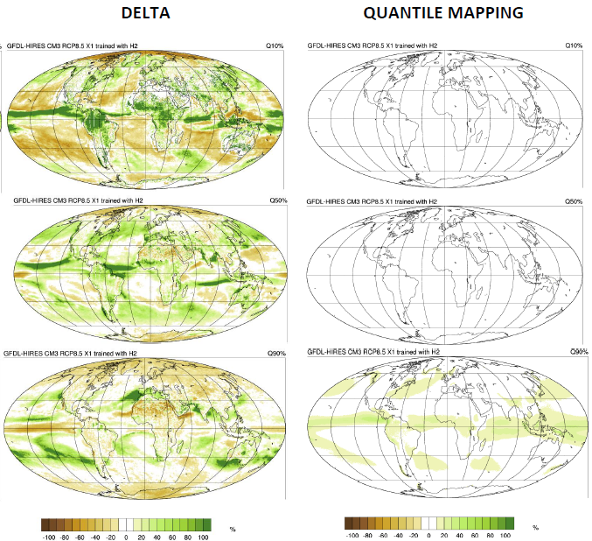
Daily wet-day precipitation
10 percentile
Median
90 percentile

Slide 23
Statistical Downscaling Disadvantages
Need lengthy and accurate observational record (minimum 20-30 years)
Cannot produce new physics (e.g. can’t get a mesoscale convective system if it isn’t in the GCM)

Slide 24
Dynamical Downscaling Techniques
A high resolution version of a climate model is applied for a limited geographical area
Because the geographical area is limited in size, higher resolution is possible because computer resources are not being used to simulate the entire globe
HOWEVER, a global model is required to establish the conditions on the boundary of the domain

Slide 25
CORDEX
CORDEX: Coordinated Regional Climate Downscaling Experiment
Coordinated by the World Climate Research Programme
Experiments being conducted/planned over all land areas

Slide 26
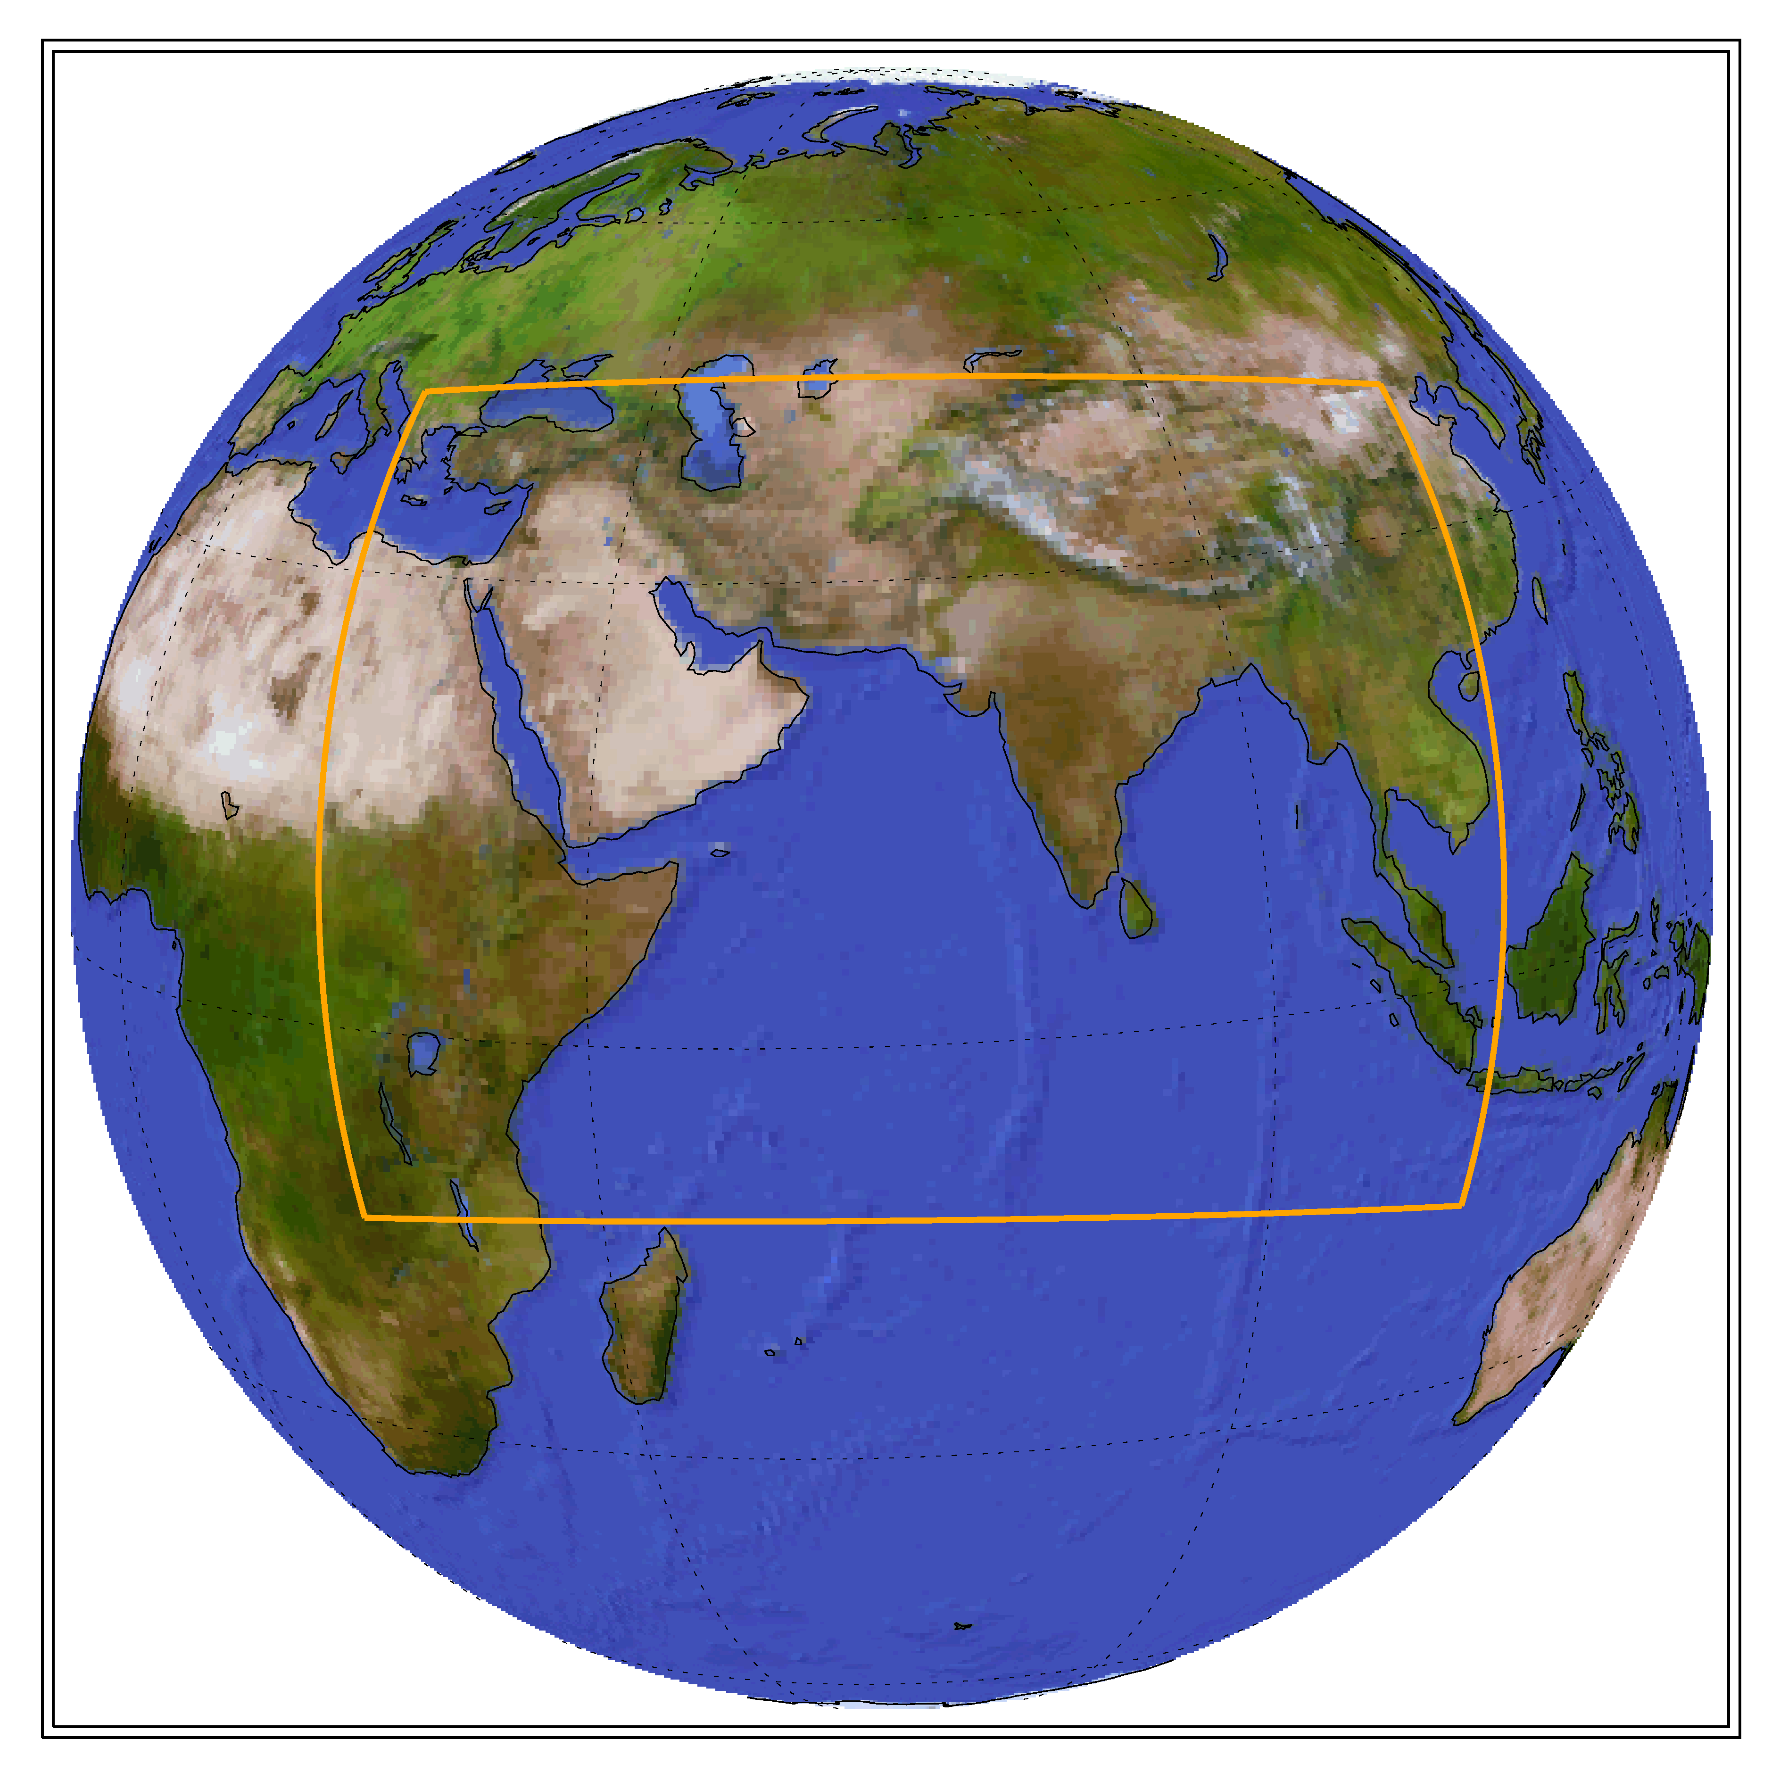
CORDEX South Asia Domain
The domain covers approximately 10% of the global surface.
Can use computer resources for higher spatial resolution

Slide 27
CORDEX South Asia Domain
A global climate model is needed to provide the conditions on the boundary of the regional climate model domain
Specify lateral boundary conditions every 6 hours

Slide 28
Dynamical Downscaling Techniques
One of the CORDEX experiments is a 25 km resolution simulation for 1950-2100

Slide 29
CWRF Improves NCAR Climate Change Projection
No of dry days (precipitation < 0.25 mm)
Observed Present-day
NCAR Present-day
NCAR Future Change
DIF
CWRF Present-day
CWRF Future Change
DIF
Present: 1980-2005
Future: 2035-2050
Notes:
Present-day Observations
Present-day NCAR Model
Present-day ESSIC Model
Future (2035-2050) Change from the Present-day
September-October-November

Slide 30
PCT95
(mm/day)
Notes:
1980-2014
The 95th percentile of daily precipitation

Slide 31
Dynamical Downscaling Advantages
The model can create its own weather, for example, for phenomena such as convective systems and tropical cyclones
Topographically-forced features can be simulated with much better fidelity

Slide 32
Dynamical Downscaling Disadvantages
Very computationally intensive
It is only practically possible to run a few experiments

Slide 33
Conclusions
Some type of downscaling is usually required to transform global climate model simulation data into something that can be applied to impacts assessments
Empirical-statistical downscaling: very inexpensive and can thus employ all available GCMs
Dynamical downscaling: can produce new physics

